Slide 1

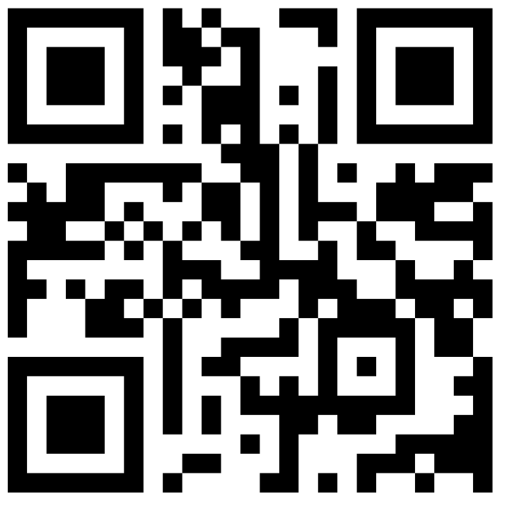

Slide 2

Who we are
800+ Members Strong: Connecting Austin’s tech, creative, and business leaders passionate about AI.
50 Active Attendees per Meeting: A mix of local innovators, enthusiasts, and early adopters.
Supportive & Engaged Community: A well-balanced Discord that’s "useful, but not overwhelming."

Slide 3
How we got started
LangChain Chat with Data Challenge: Harrison Chase posted a RAG challenge as part of the LangChain Project
I found fraud in my supply chain: I combined interviews, emails, and documents into RAG. Exposed Fraud protected me from SEC Violation at Always Cool Brands
Shared with the Community: I showed my code at a local bar. 1.5 years later, we have 800 members…

Slide 4
AIMUG Events & Activities 🌟📅
Monthly Showcases & Mixer: Community members share projects and demos; labs for hands-on learning.
Next Meeting: Wednesday, November 13th, 6 PM
Hacky Hours (Mid-Month): Informal happy hours at local spots; meet, discuss, and relax.
Weekly Virtual Syncs: Tuesdays & Thursdays at 2 PM – Workshopping, problem-solving, and AI discussions.

Slide 5
Where to Connect & Stay Updated 📲
Website: aimug.org – All things LangChain and AIMUG.
Discord: Join us for ongoing conversations.
GitHub: Austin LangChain Repo – Check out our open-source projects.
Meetup: Austin LangChain Group
Twitter: @AustinLangChain – Latest updates and AI news.
YouTube: Austin LangChain Channel – Watch replays and tutorials.

Slide 6
A Welcoming Culture of Learning & Growth 🤝🌱
Low-Stress, Collaborative Environment: We welcome questions, ideas, and collaboration.
Connect with AI Enthusiasts & Early Adopters: Find mentors, partners, or friends who share a passion for AI.
Our Motto: Learn, Share, Grow – Together, we’re advancing the AI landscape.

Slide 7
